Slide 1

A'thar: Smart automated Roads Enhancement

Slide 2


Background
Roads make a huge contribution to the economy of a territory. As a platform for transportation, roads are widely used by every country in the world. Potholes in road are one of the major concerns in the transportation infrastructure.
The need of adequate potholes detection methodologies with low-cost, accurate, reliable techniques become essential.

Slide 3
Pothole Detection Methodology

Slide 4

Pothole Detection Methodology
As-is methodology
Pavement condition assessment and detection and reporting techniques are manual and time-consuming.
Proposed methodology
Leveraging technologies such IoT andincluding citizens in the equation to solve and detect road damages can prioritize and invest on the critical potholes through full cycle of automation.

Slide 5








Simplifed Architecture
Real-time Frame Extraction
(While vehicle moving)
City clerk
NAJM
ETC
City/Smartathon Platform
Pothole Detection
Front-end
API GATEWAY
Pothole Properties
Report
Machine Learning Engines
Reports / Critical Potholes Locations, etc..
Citizen
City Officials

Slide 6

Alogrthim Methodolgy

Slide 7

Machine Learning Modeling
Datasets
Model Implemation
Two public dataset are used for the training.
*Dataset can be found in the notebook!
State-of-Art Yolov7-tiny used for model training (lightweight and outperforming other object detection models)

Slide 8
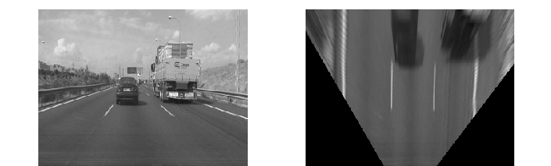
Pothole Propities Estimation
Area Estimation
To accurately calculate the area, inverse perspective mapping are used to project the frame into bird-view.

Slide 9
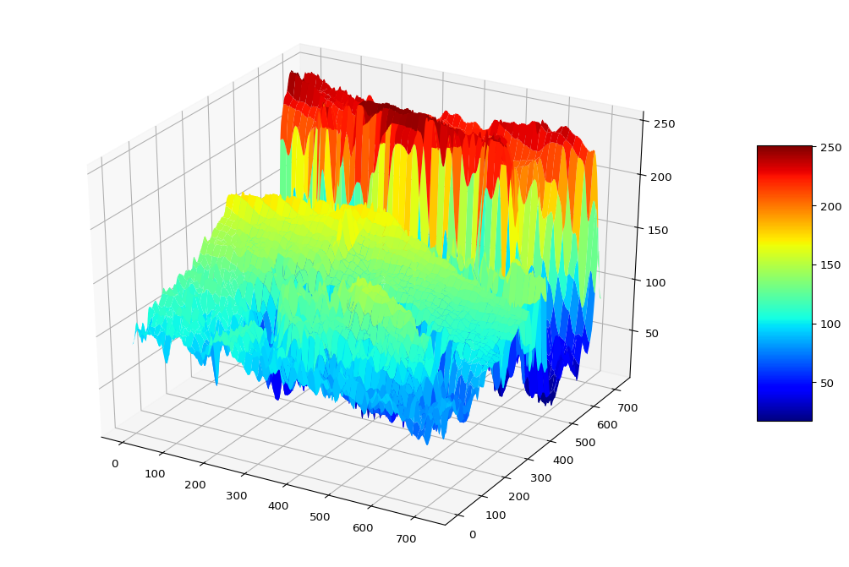
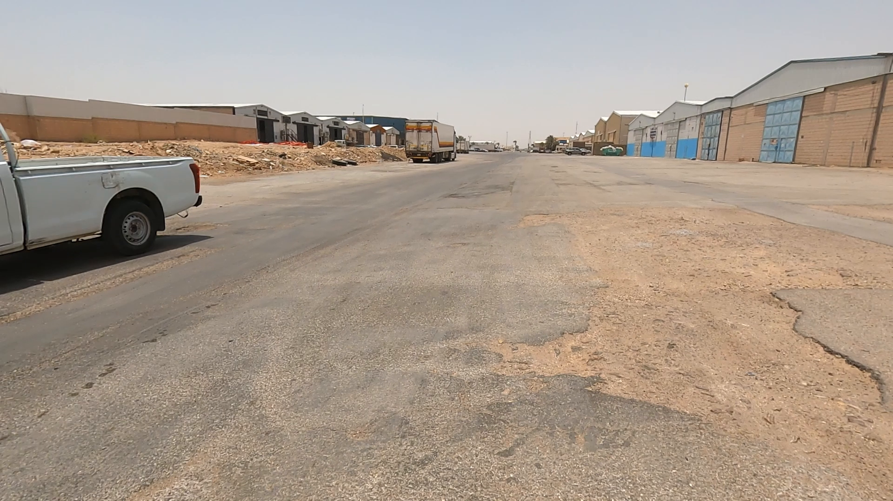
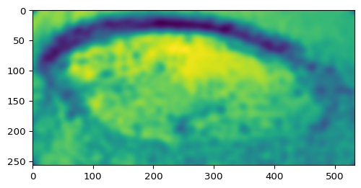
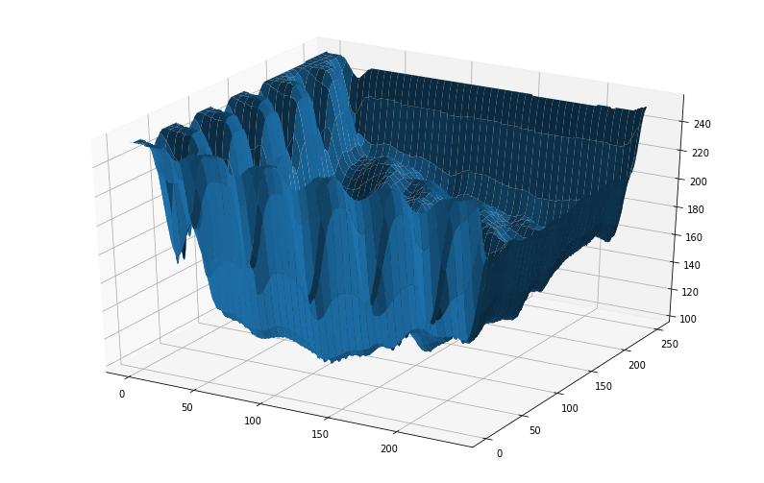
Pothole Propities Estimation
Depth Estimation
The road are projected in to 3D projection and then ROI extracted with gaussian filter applied to de-noise the projection. From the projection the depth are calculated (with outliers are removed) then pixels are converted to cm^2

Slide 10
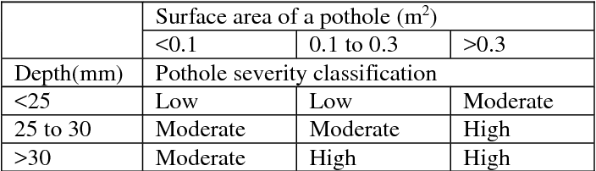
Pothole severity classification
Malasysian Pothole severity classification are adopted to estimate the severity of potholes
Pothole severity classification in Malaysia*
*: https://www.semanticscholar.org/paper/A-Guideline-for-Pothole-Classification-Kim-Ryu/3602b2da73eff4d294fc7ce5accb42e11a12281d

Slide 11
Smartathon/City Platform Demo

Slide 12

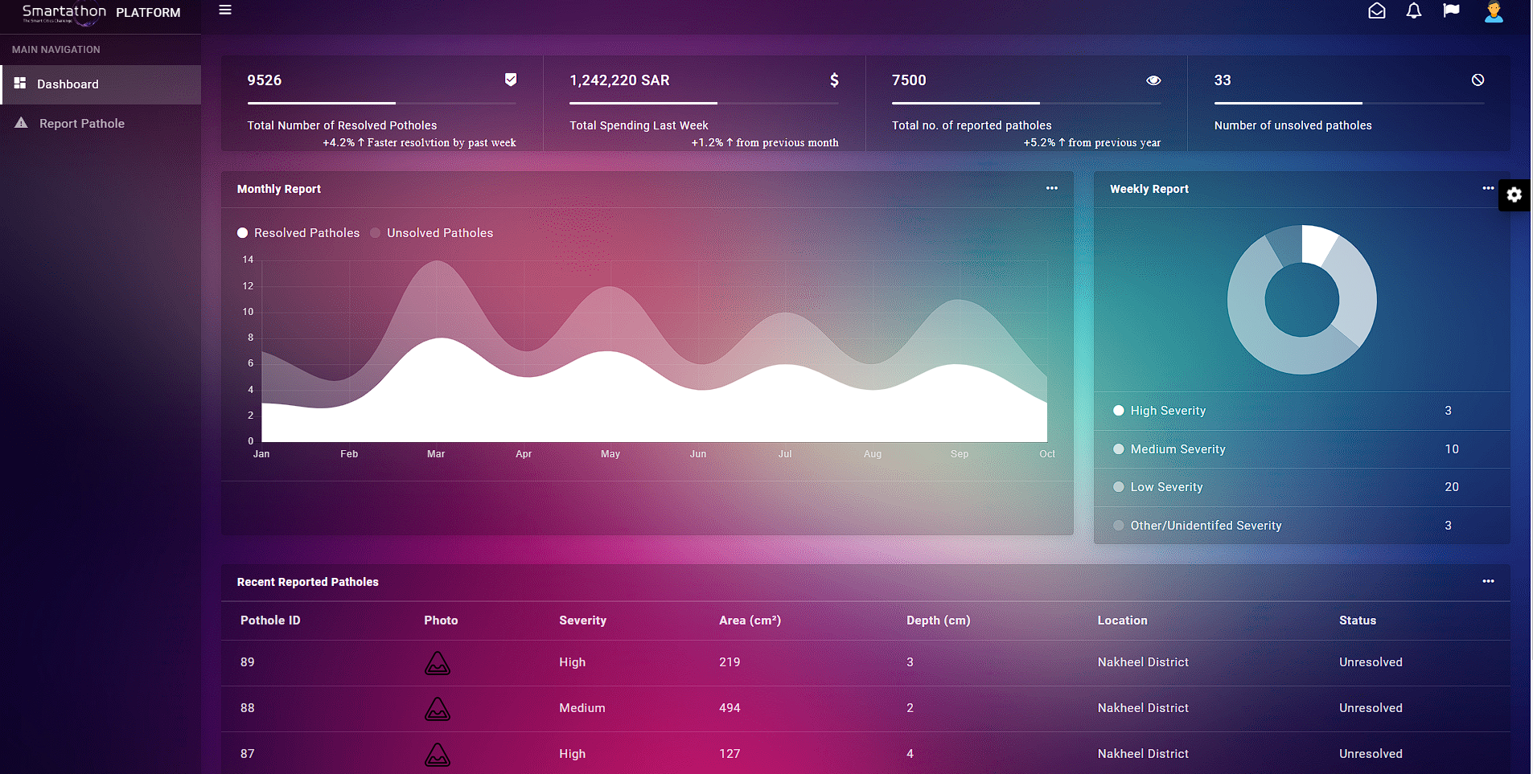
Smartathon Platform Demo

Slide 13
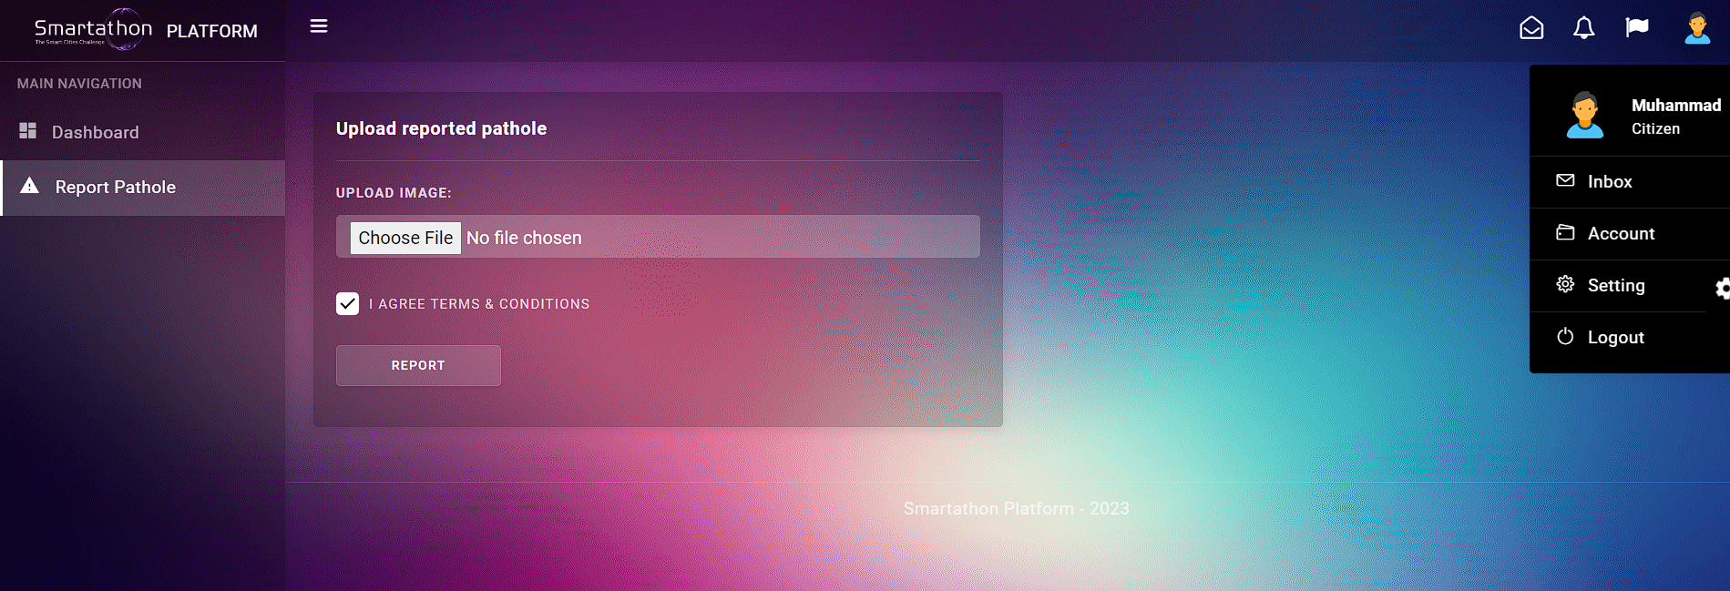
Smartathon Platform Demo

Slide 14
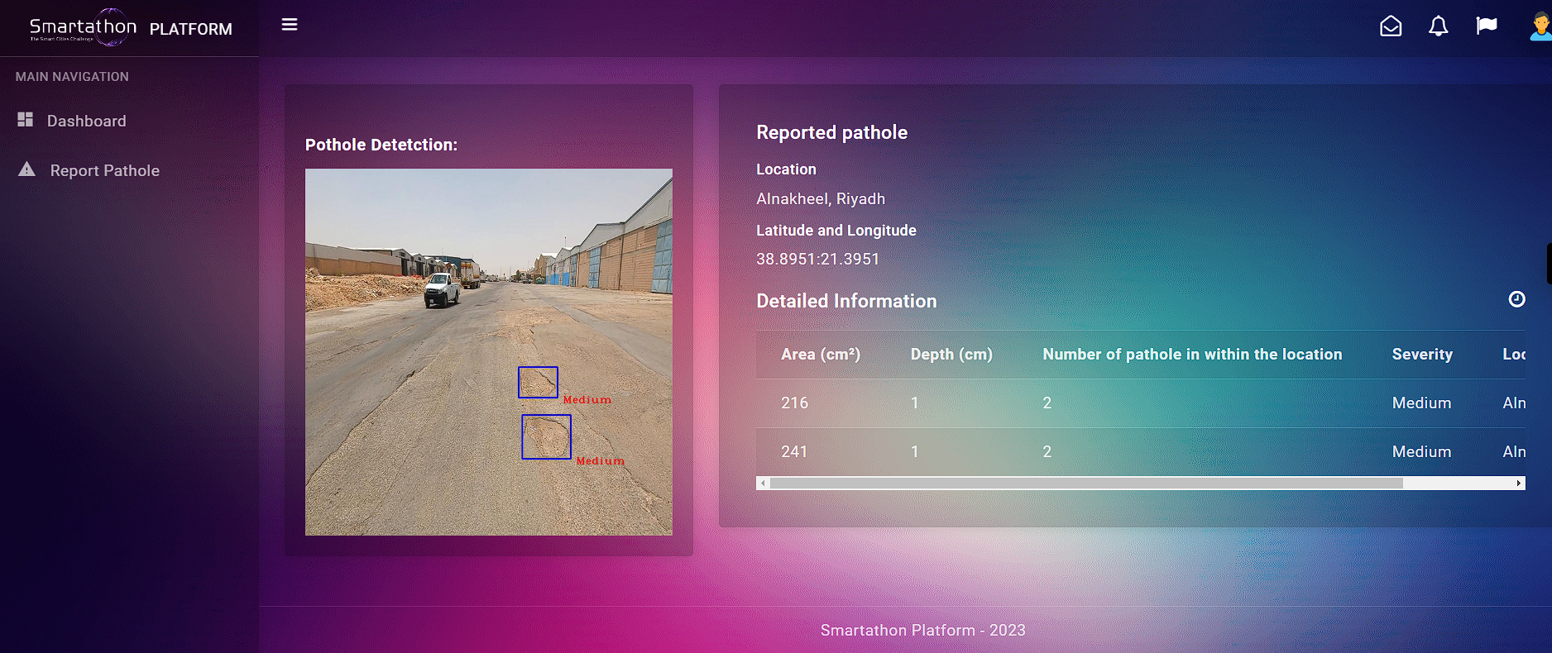
Smartathon Platform Demo
*The image from the hackathon’s dataset

Slide 15
http://3.8.91.251/
Link to the demo

Slide 16
Thanks!

